Slide 2
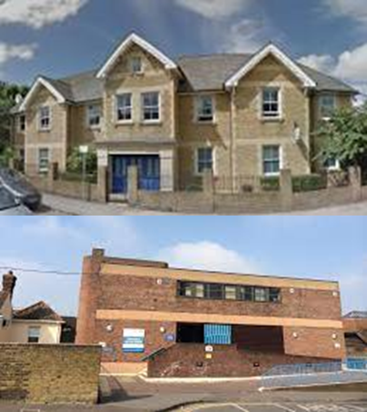
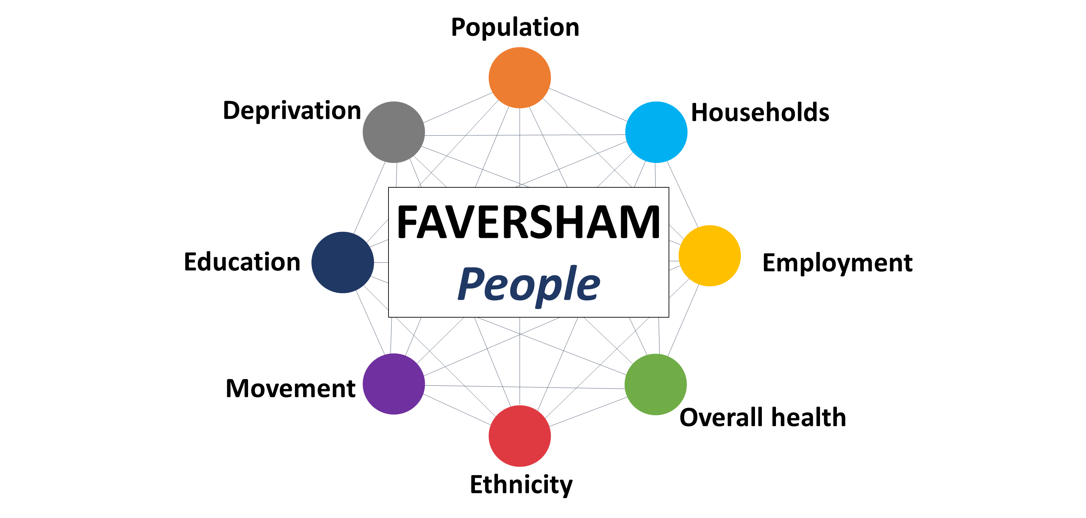
supported by
the process
Stage 1 starts with the pop-up exhibition in the town hall and a questionnaire being circulated across the town and local villages. This will help us understand and report on how people feel about health and health care and what developments they would like to see in the future.
For Stage 2 we will form a Citizen Expert Panel to explore the evidence and work with researchers, planners and providers to develop a picture of the services Faversham residents will need and what resources –staff, technology and buildings - will be required to deliver them.
the beginnings
With this in mind, patient representatives from our two GP practices talked about the problem and contacted a health research group at the University of Kent. They were really helpful and an outline project design emerged. We then talked to the Community Committee of Faversham Town Council and as a result the Faversham Healthy Futures (FHF) project has been created.
why bother?
No matter how the current crises in health care get resolved, we need a clear view of the town’s future health and care needs to guide decisions of planners and politicians. Unfortunately, the NHS has not been used to planning for small, relatively self-contained (but growing!) communities like ours.
the team
from Faversham
Gill Wagstaff, Laurie McMahon,
Graham Elvy, Jacqui Dabnor, Andrew Holden,
Cllr Carole Jackson, Cllr Alison Reynolds,
Cllr Hannah Perkin
advisors from University of Kent...
Dr Melanie Rees-Roberts, Mr Steve Childs, Dr Rebecca Cassidy, Dr Ambrose Gillick, Dr Sarah Hotham, Dr Amanda Bates.

Slide 3
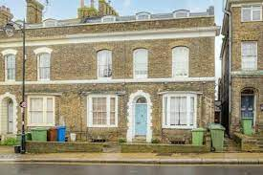
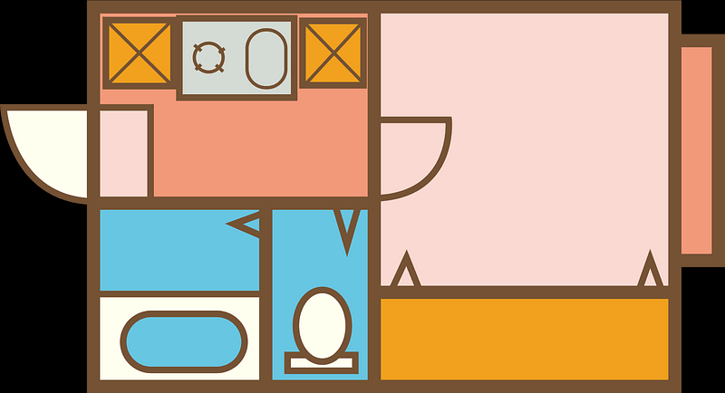
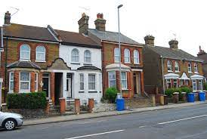
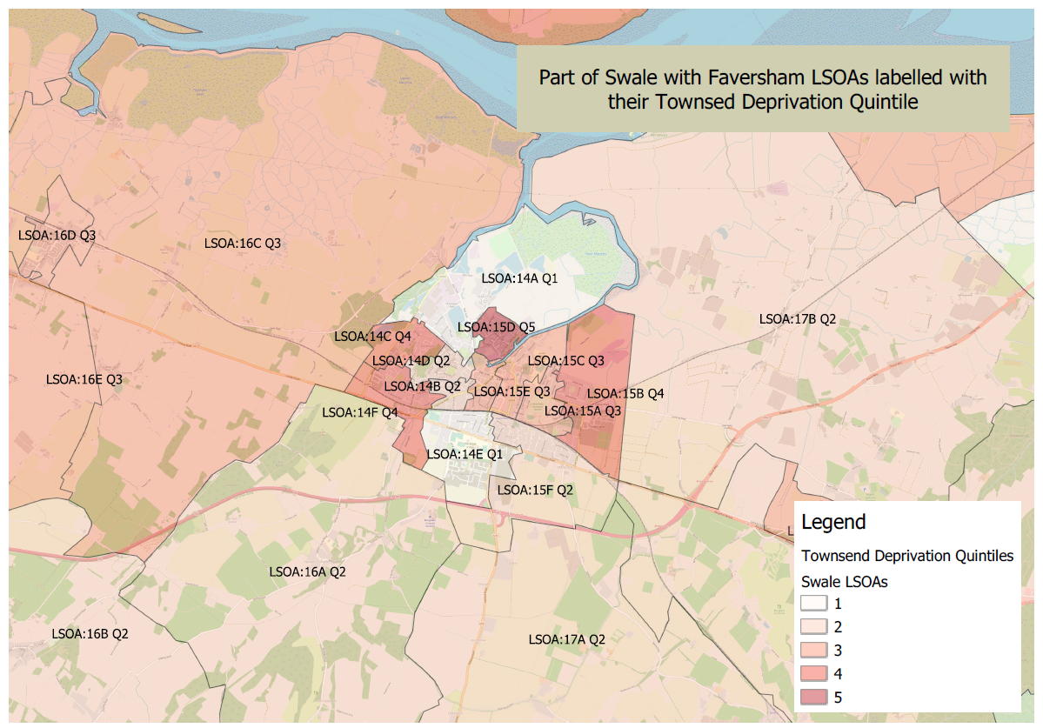
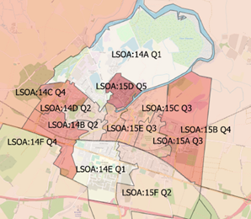
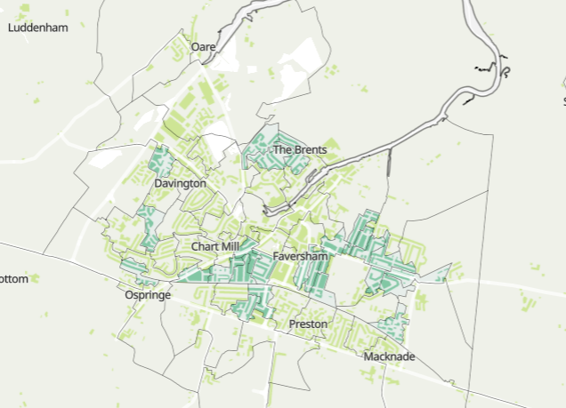
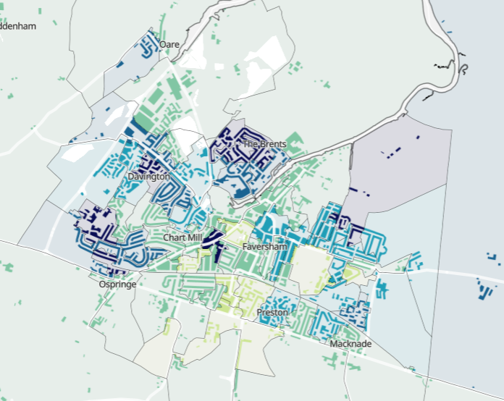
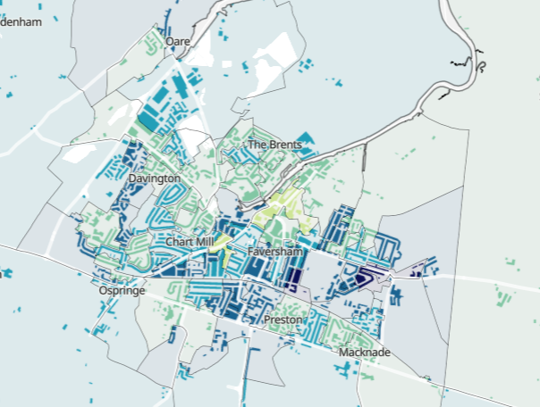
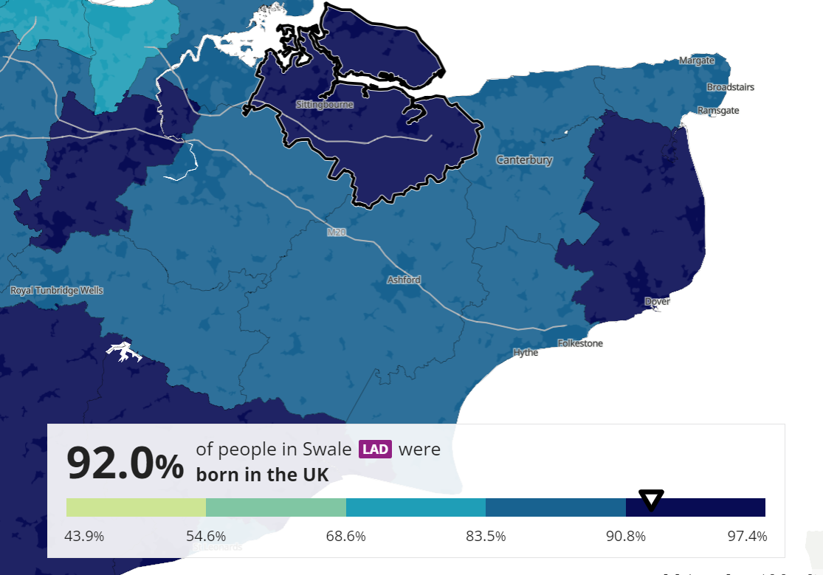
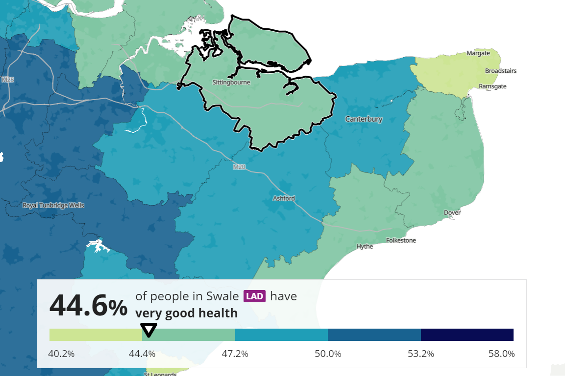
Data taken from the 2021 Census, Office for National Statistics (ONS) https://www.ons.gov.uk/census/maps
Apart from population pyramid – taken from ONS mid-2020 population estimates
Population
In the 2021 census, 20,936 people lived in Faversham. A further 15,319 people live in neighbouring areas around the town.
Data covers Medium Super Output Areas (MSOAs)
Faversham West (Swale014) and Faversham East (Swale015)
Deprivation
Households
One factor which can affect health is deprivation of an area. 46.8% of households in Faversham are not deprived in any dimension
Faversham is a family town
65.8% of households are single-family households
29.1% are one-person households
5.2% of households are other type
Most households are small in size with only 1 or 2 people
Local deprivation has been mapped for each local neighbourhood below. A score of 5 (darkest shading) shows areas within the 20% most deprived iarea of the UK.
“Deprivation scores in Faversham town and the surrounding urban and rural communities”
52.2% of people in Faversham are Female
Number of bedrooms | Percent
1 | 6.6%
2 | 31.2%
3 | 43.7%
4 or more | 15.5%
The average age of people in Faversham is 43 years
4 or more person households
18.4%
1 person households
29.1%
18.5% of people in Faversham are aged 15 years or under
3 person households
16.0%
80.5%
of households
own 1 or more
Least deprived
Persons per square km
The Faversham population has increased 6% since 2011 (by 1,121 people). Surrounding catchment areas have increased more by 12%, up by 1582 people.
2 person households
36.5%
Most deprived
21.6% of people in Faversham are aged 65 years or older
Housing conditions - good
3.4% are overcrowded
70.2% are under- occupied
Each shaded zone on the map represents a similar population of approximately 1,500 residents or 650 households. There are 32,844 of these areas across England.
Education
Population
Employment
Distribution of the population with no qualifications
% of population that are economically active
Highest qualification
Deprivation
Households
Of those not in employment:
20.9%: never worked
9.8%: worked in last
12 months
69.4%: not worked in
last 12 months
Hours
worked
19.8%
No qualifications
6%
Apprenticeship
FAVERSHAM
People
31.1% part-time
18.7% of Faversham residents were a full-time student (includes ages five to adulthood)
Education
Employment
31.3%
University
qualifications
40.9%
School qualifications
Movement
68.9% full-time
Overall health
Management
Small employers
Unemployed
Types of occupation:
34%
12%
11%
5%
25%
Other
6%
6%
2.4% other
Ethnicity
Intermediate occupations
Supervisory/
technical
Students
Movement
Overall health
Ethnicity and Culture
People in Swale self-rated their overall health as:
Ethnicity:
UK Identity:
94.7% have UK identity
1.5% have UK and non-UK 4.4% have non-UK identity
Swale
comparison
Faversham ethnicities
In the Census data this information on movement is only available at the Swale level
0.5%
0.6% Other ethnic group
In the Census data this information on movement is only available at the Swale level
2.3%
0.8% Black, Black British, Black Welsh, Caribbean or African
1.5%
1.1% Asian, Asian British or Asian Welsh
95.3% of households have English as the main language
1.8%
1.7% Mixed or multiple ethic group
93.8%
95.9% White
Religious belief:
44.6% are married or in a civil partnership
45.7%
Christian
0.6%
Muslim
11.0% of people had moved to Faversham from elsewhere in UK
0.6%
Muslim
Sexual orientation:
Heterosexual – 90.7%
LGBQT+ – 3.1%
Not answered – 6.2%
88.7% of people had the same address as last census
0.25% of people had moved to Faversham from outside the UK
47.1%
No religion
0.1% Sikh
Very good health – 44.6%, Good health – 35.2%, Fair health – 14.4%
Bad health – 4.5%, Very bad health – 1.3%
1.3%
Other
0.2% Jewish
0.3% Hindu
0.4% Buddhist
0.4% Other
Data collated by Dr Melanie Rees-Roberts and Steve Childs, Centre for Health Services Studies, University of Kent

Slide 4
Our local health Data from the Kent Integrated Dataset* How does Faversham compare to Kent and Medway on health conditions?
Top 10 Long Term Conditions
Overall, Faversham’s health is generally in line with the rest of Kent & Medway
The Office for National Statistics calculates an overall Health Index Score to help compare areas across England.
A score higher 100 indicates improvement in health since 2015 and a score lower than 100 a decline in health score.
Swale scored 93.8 in 2021.
Up 1.7 points from 2020
Swale’s best score is 106.9 for ‘physical health conditions’
Top 10 conditions Ranked 1st - 10th | Health condition | % of people in KENT with condition | How does FAVERSHAM compare?
1st most common condition | Obesity Being overweight – Body Mass Index of 25 or more. | 14.9% | 13.6%
2nd most common condition | Hypertension High blood pressure – over 140/90mmHg | 11.7% | 11.8%
3rd most common condition | Depression Persistent sadness, low mood and loss of interest in daily life. | 11.0% | 11.6%
4th most common condition | Anxiety Feelings of unease, including worries and fear. | 9.3% | 9.6%
5th most common condition | Diabetes Consistent high sugar levels in the blood. | 9.0% | 8.7%
6th most common condition | Asthma Attacks or spasms in the lungs causing difficulty in breathing. | 8.0% | 9.1%
7th most common condition | Osteo Arthritis Pain, stiffness and movement problems in the joints. | 5.7% | 5.6%
8th most common condition | Bronchitis Infection of the main airways of the lungs (bronchi). | 5.0% | 2.1%
9th most common condition | Migraine Moderate to severe headaches often with throbbing pain. | 4.9% | 4.6%
10th most common condition | Anaemia Low number of red blood cells or low iron levels in the blood. | 3.3% | 3.1%
Current life expectancy for Faversham citizens is 82.0 (2018-20)
Females in Faversham live an average 3.7 years longer than males (2018-20)
HOWEVER, parts of Faversham have poorer health and this is linked to areas with higher levels of deprivation within the town
Life expectancy peaked at 84.5 years in
2012
Most affluent/least deprived
Least affluent/most deprived
Health condition | % of least affluent Areas most heavily shaded/ labelled Q4 & Q5 on above map (Swale 014C, 14F, 15B, 15D) | % of average affluence Areas lightly shaded/labelled Q3 on above map (Swale 015A, 015C, 015E) | % of most affluent Areas not shaded/labelled Q1 & Q2 on above map (Swale 014A-D, 15F)
Obesity | 20.0% | 16.1% | 15.7%
Hypertension | 12.8% | 15.2% | 15.0%
Depression | 19.7% | 16.7% | 13.8%
Anxiety | 14.9% | 13.7% | 11.1%
Diabetes | 13.1% | 11.1% | 10.2%
What are your thoughts on the health of Faversham?
*Data taken from, Kent Analytics, ONS and the Kent Integrated Dataset (KID) – an anonymised dataset for Kent and Medway which analyses long term health conditions – data from 2019. Data from the KID covers central Faversham and some wider catchment areas as displayed in deprivation map on Faversham Folk poster – Swale014 and Swale 015 LSOA’s.
Data collated by Dr Melanie Rees-Roberts and Steve Childs, Centre for Health Services Studies, University of Kent

Slide 5
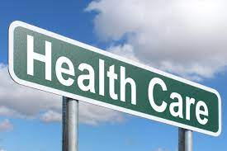
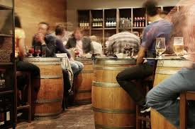
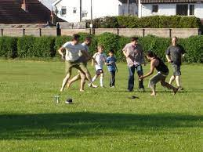
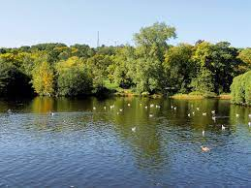
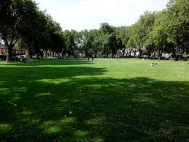
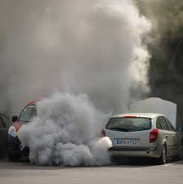
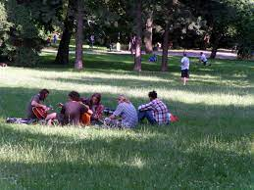
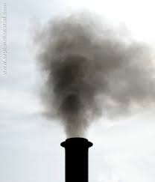
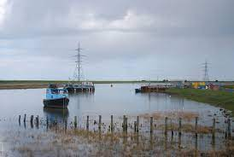
Faversham environment
Data covers Medium Super Output Areas (MSOAs)
Faversham West (Swale014) and Faversham East (Swale015)
Accessibility of services and the environment
Here we show the average distance of travel for Faversham citizens to various services and activities:
Leisure activity | Average Distance (km) | National Rank (1 being among best areas and 10 being among worst areas in country for access)
Leisure centre | 1.3km | 3 (easy access)
Fast food store | 0.9km | 7 (slightly poorer than average)
Gambling outlet | 1.2km | 6 (about average)
Off licence | 11.1km | 2 (easy access)
Pub/bar/nightclub | 0.8km | 8 (poor access)
Shops selling tobacco | 1.1km | 9 (poor access)
Service | Average Distance (km) | National Rank (1 being among best areas and 10 being among worst areas in country for access)
Emergency Department (A&E) | 25.9km | 10 (poor access)
GP practice | 1.2km | 6 (about average)
Dentist | 1.0km | 5 (about average)
Pharmacy | 1.0km | 6 (about average)
Leisure
Here we data about the air quality in Faversham:
Here we show what access to open space is like in Faversham:
NO₂
Nitrogen dioxide, or NO₂, is a pollutant formed when fossil fuels such as coal, oil, gas or diesel are burned at high temperatures.
Particle pollution — also called particulate matter (PM) — is made up of particles (tiny pieces) of solids or liquids that are in the air. These particles may include: Dust. Dirt. Soot.
Sulphur dioxide (SO₂) emissions are from burning fossil fuels. There has been a general decrease in SO₂ since 2019 when lower sulphur content fuels were prioritised.
PM10
SO₂
Air quality measure | Level | Comparison to England
Level of nitrogen dioxide (NO2) | 11.3 | Average compared to other areas across England
Particulate matter (PM10) | 15.3 | Bad (higher levels) compared to other areas across England
Level of Sulphur Dioxide | 0.96 | Good (lower) levels compared to other areas across England
Faversham has good access (compared to the rest of the country) to ACTIVE GREEN spaces where people can exercise and undertake active leisure activities alone or in groups
Faversham has slightly poorer than average access to PASSIVE GREEN space for sitting, socialising or passive recreation
Access to water or blue space is very good.
Data taken from Consumer Data Research Centre (https://www.cdrc.ac.uk/) Access to Health Assets and Hazards dataset - 2017

Slide 6
Not all clinics and services are available at both practices
Child Health 0-6 years
Child Health 7-15 years
Clinical Pharmacists
Contraception
COPD
Diabetes
Doppler
Electrocardiogram (ECG)
Immunisations
Leg Ulcers
Mental Health Social Prescribing
Mental Health to age 25
Minor Surgery
NHS Health Checks
Ophthalmology
Phlebotomy (Blood test)
Physiotherapy
Podiatry
Spirometry
Travel Vaccinations
Ultrasound
Vaccinations
X-ray
Acute care
William Harvey Hospital Ashford includes A&E
Queen Elizabeth Queen Mother Margate includes A&E
Kent &Canterbury Hospital includes UTC
Two GP Practices looking after 33,357 patients
Feb 2023
Specialist Clinics
Dementia
Depression
Dermatology
Ophthalmology
A referral is required for nearly all clinics and services
Faversham Healthy Futures
Tertiary Care
London Hospitals for Neurosurgery, Transplants, Plastic Surgery and much more
Anticoagulation
Asthma
Audiology
Blood pressure
Blood pressure
24-hour monitoring
Catheter Management
Cervical Screening
Kent Community Health Foundation Trust
Cottage Hospital
Community Nurses
Health Visitors
Occupational Therapists
Physiotherapy
+ many more services
Urgent Treatment Centre
Minor Injuries
Cuts, wounds, grazes, eye and ear injuries, bites, abscesses, falls, burns, strains and foreign bodies
Minor Illness
Infections, rashes, emergency contraception (morning after
pill), coughs and colds.
Health & Care Professions
Chiropody/ Podiatry
Optician
Physiotherapy
Speech & Language Therapy
Dentists
4 practices taking NHS & private patients
Charites supporting health and wellbeing
Age concern
Citizens advice
Abbey Physic Garden
Umbrella
West Faversham community Centre
+ many more
Complementary & Alternative Medicine
Osteopathy
Chiropractor
Reflexology
Acupuncture
Pilates
Yoga
Mind – body therapy
+ many more
Pharmacists
4 pharmacies
Faversham now

Slide 7
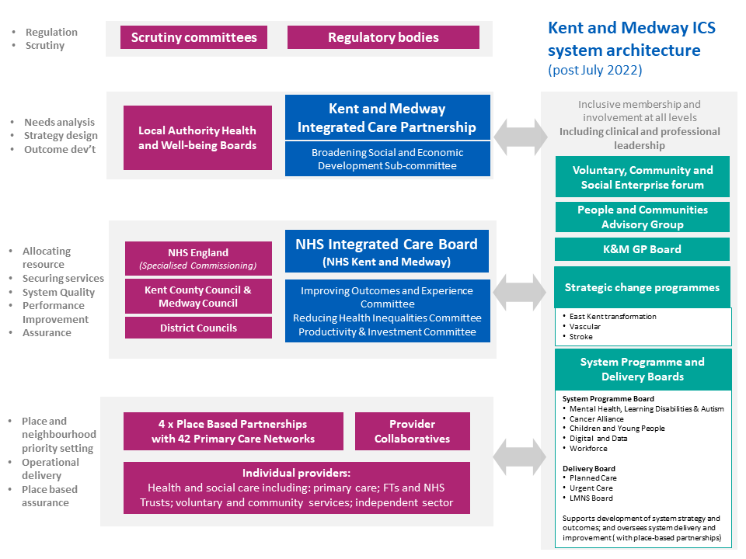
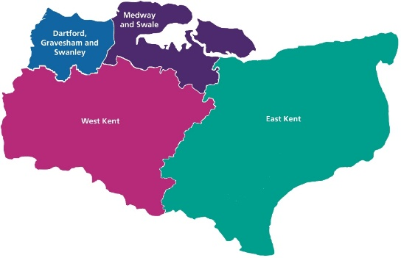
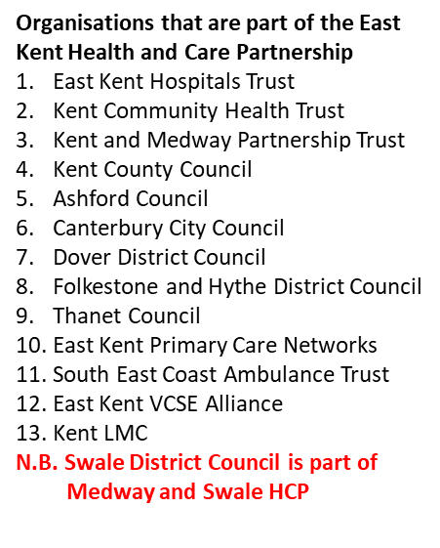
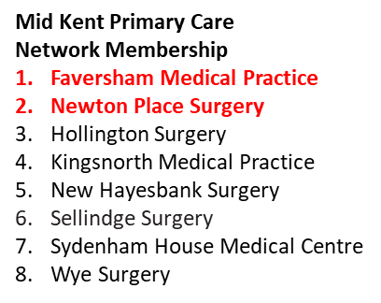
NHS Executive + CQC
The 4 Kent and Medway Health Care Partnerships
The Kent & Medway
Integrated Health and Care
‘system architecture’

Slide 8
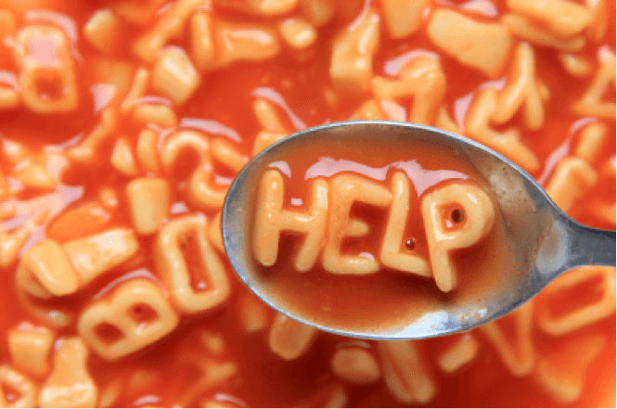
Acronym Soup
The Alphabet Soup of Integrated Care!
DHSC
NHSE
CQC
ICS
ICB
ICP
HaCP
PBP
PCN
LMC
HOSC
HWB
VCSE
____
____
____
Department of Health and Social Care
National Health Service England
Care Quality Commission
Integrated Care System
Integrated Care Board
Integrated Health Partnership
Health and Care Partnership
Place Based Partnership
Primary Care Network
Local Medical Committee
Health Overview and Scrutiny Committee
Health and Wellbeing Board
Voluntary, Community and Social Enterprise
_______________________
_______________________
_______________________
These are just a few acronyms that relate to integrated care. There are many more – and names and titles have changed frequently. It’s confusing even to people who work in the system! The address below might help but we’ve left spaces for you to add any obvious ones we missed!
https://www.nhsconfed.org/publications/acronym-buster?alphabet=I

Slide 9
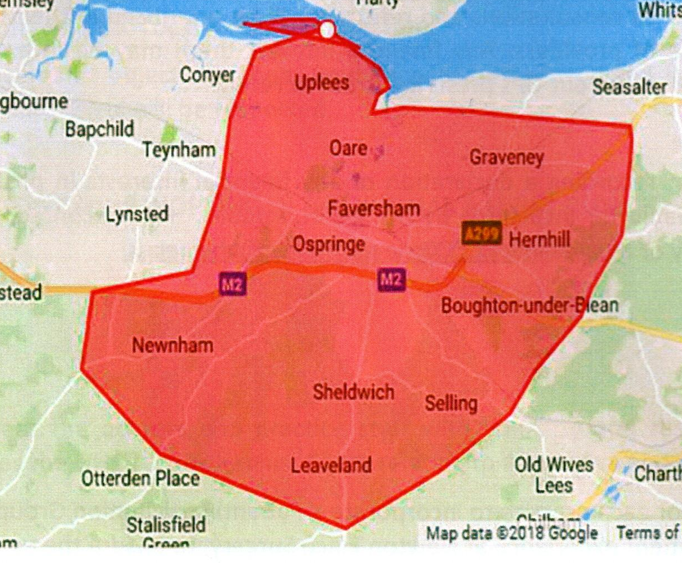
GP SURGERIES CATCHMENT AREA
Faversham Medical Practice – approx. 2 mile radius from Faversham
Newton Place Surgery – approx. 5 mile radius from Faversham

Slide 10
Jan-22 | 32005
Feb-22 | 32210
Mar-22 | 32351
Apr-22 | 32419
May-22 | 32496
Jun-22 | 32627
Jul-22 | 32758
Aug-22 | 33086
Sep-22 | 33229
Oct-22 | 33347
Nov-22 | 33321
Dec-22 | 33279
Jan-23 | 33357
Feb-23 | 33366
Source: NHSE GP Data Hub

Slide 11
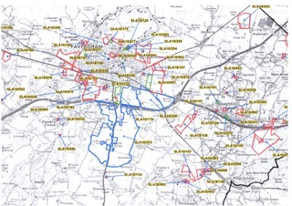
So, what about housing developments?
1
In the planning process there is no requirement to consider the implications for healthcare infrastructure. However some developers are more sensitive to these and related issues than others.
2
Predicting future health and care needs for our current population is not that easy, but it can be done. Predicting the additional needs that big housing developments will generate however is much more difficult…
5
So, we might expect our policy makers and planners to scan ahead frequently, ensure all public and private agencies work together and plan with local people in an integrated, community-based way. They need to anticipate new demands and respond nimbly – not wait till there are waiting lists and shortages.
3
For a start, the planning process – which is the responsibility of Swale Borough Council but with strong central government targets - is unpredictable in terms of the scale, location and time-frame of new developments.
4
….. and the rate at which developers choose to build houses on approved sites is relatively unpredictable. As a result, there is no easy way of calculating the rate of population growth nor indeed the characteristics (and therefore needs) of the people that move into the houses.

Slide 12
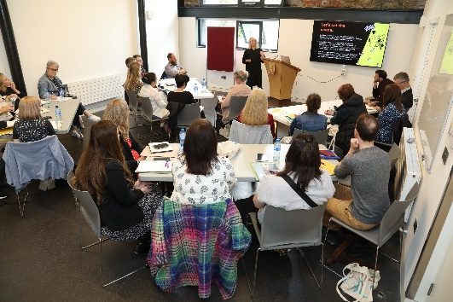
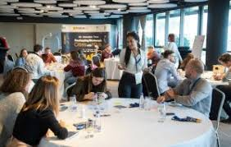
supported by:
Building Phase 2
The next phase will move on to identify what health and care services Faversham will need in the future. We have some early ideas about the process but we know it must be citizen-centred and informed by the evidence and aspirations of planners and providers.
and so what next?
Analysis
Obviously the first thing the team have to do is to carefully analyse all the information from the questionnaires and the comments you have made during the exhibition.
Reporting
We will then prepare a report that we will present to the Faversham Town Council. We can also present it to other Councils in our neighbouring villages. We will publish the report online for all participants and the wider public to see.
Recruiting the citizen-experts
Some of you have you want to stay more directly involved. So, we will gather together a representative group and develop their expertise in understanding the complexities and trade-offs involved in planning healthcare services. Then, though a facilitated process, this group will become the heart of the project - engaging directly with planners, providers and policy makers to help ensure Faversham becomes a healthier place.
Engaging our ‘friends’
We hope a large number of local people will have said that they want to stay informed about the progress of the FHF project. We will provide regular updates on the development of the next phase and be able to respond to any ideas or concerns you may have.

