Slide 1


A ‘Big Live Talk’ Health Event
Faversham and the NHS 10 Year Plan -
what should our neighbourhood expect?
Mid Kent INT Working Group
a community-led research and planning project supported by
Notes:
Holding slide

Slide 2
Faversham and the NHS 10 Year Plan
Some background……
The FHF project began because…
Demise of our local Commissioning Group and the ‘centralisation’ of decision-making at a Kent and Medway level
Concern about how local voices would be heard in planning joined-up health and care services for smaller communities like ours
Impact of extensive house building in and around the town
Progress so far…
The 2023 Healthy Futures Exhibition and Survey
(for full report see FHF website)
The 2024 Faversham Healthy Futures ‘Live Talk’
(for full report see FHF website)
Output: a clear and comprehensive view of what local people expected from their health and care system in the future…

Slide 3
Faversham and the NHS 10 Year Plan
our purpose tonight…
To hear from local health and care service providers about how the NHS 10 Year Plan will deliver the improvements we need.
To clarify where the responsibilities will lie for planning and delivering our services in the future
To understand how the Faversham community and its health and care providers can develop effective ‘partnership working’ at a neighbourhood level.

Slide 4
Faversham and the NHS 10 Year Plan
Tonight’s Programme
6.15 Gathering – after registration, participants will be able to meet with contributors and facilitators.
6.45 Welcome and introduction to the Faversham Healthy Futures Project
Gill Wagstaff and Laurie McMahon
7.00 The 10 Year Plan – Question Time for Providers – Contributors:
Dr. Jonathan Bryant, GP; Medical Director, East Kent H&CP; Primary Care Clinical Lead, Kent and Medway Cancer Alliance
Pauline Butterworth, Deputy Chief Executive and Chief Operating Officer, Kent Community Health NHS Foundation Trust
Rachel Dalton, Chief Allied Health Professional Officer, Kent Community Health NHS Foundation Trust
7.40 Facilitated Discussion Groups
8.20 Facilitators’ Feedback
8.45 Closing Remarks and Meeting Close
Cedi Frederick, Chair, Kent and Medway Integrated Care Board
Notes:
Delete Karen Sharp add Anne Ford Deputy Director East Kent Health & Care Partnership;
Sadia Rashid: Chair of East Kent GP Committee; Co-Chair of Clinical and Quality Group for East Kent Health & Care Partnership; Clinical Director for Mid Kent Primary Care Network; General Practitioner
Jonathan Bryant : Medical Director East Kent Health & Care Partnership; Primary Care Clinical Lead for Cancer Kent & Medway Cancer Alliance; General Practitioner.
Allow 40 minutes for feedback – 4 minutes each if there are 10 facilitators
8.40 – Mel to say something
8.45 – Closing remarks
8.55 – Cottage hospital

Slide 5
Faversham and the NHS 10 Year Plan
Tonight’s Contributors…
Dr. Jonathan Bryant, GP; Medical Director, East Kent H&CP; Primary Care Clinical Lead, Kent and Medway Cancer Alliance
Pauline Butterworth, Deputy Chief Executive and Chief Operating Officer, Kent Community Health NHS Foundation Trust
Rachel Dalton, Chief Allied Health Professional Officer, Kent Community Health NHS Foundation Trust
Cedi Frederick, Chair, Kent and Medway Integrated Care Board
Notes:
Amend as slide 4

Slide 6
Faversham’s starting point…
Participants’ comments, concerns, issues and advice from the 2024 event.
Improving access, quality and efficiency by decentralising and localising services and…
Integrating and managing those services locally.
Securing the right human and physical resources to do that
Associated concern that the current local buildings/facilities not being utilised to best effect
Rebalancing provision of care to include more home/social support/ health promotion/etc.
Stronger focus on preventing illness - rather than just treating it.
Better local mental health and NHS dentistry services urgently required
More emphasis needed on supporting young people –
Tackling the immediate problem of obesity – especially in school-age children
Concern that NHS not reassuring public about the impact of any new housing developments on services
Concern too that L.A. planning process does not focus enough on creating healthy environments – open spaces/cycling/walking/air quality/water treatment etc. Does the NHS have any influence?
Particular concern about how S106 was to be used in planning health and care facilities/services
Notes:
This!
Key points highlighted here
access, quality AND efficiency by localising and decentralising
PLUS the move to prevention –
(Ara and Wes must have been in the room! )
Leading (segueing) neatly to the focus for this symposium.

Slide 7
Faversham’s starting point…
Participants’ comments, concerns, issues and advice from the 2024 event.
Improving access, quality and efficiency by decentralising and localising services and…
Integrating and managing those services locally.
Securing the right human and physical resources to do that
Associated concern that the current local buildings/facilities not being utilised to best effect
Rebalancing provision of care to include more home/social support/ health promotion/etc.
Stronger focus on preventing illness - rather than just treating it.
Better local mental health and NHS dentistry services urgently required
More emphasis needed on supporting young people –
Tackling the immediate problem of obesity – especially in school-age children
Concern that NHS not reassuring public about the impact of any new housing developments on services
Concern too that L.A. planning process does not focus enough on creating healthy environments – open spaces/cycling/walking/air quality/water treatment etc. Does the NHS have any influence?
Particular concern about how S106 was to be used in planning health and care facilities/services
Notes:
This!
Key points highlighted here
access, quality AND efficiency by localising and decentralising
PLUS the move to prevention –
(Ara and Wes must have been in the room! )
Leading (segueing) neatly to the focus for this symposium.

Slide 8
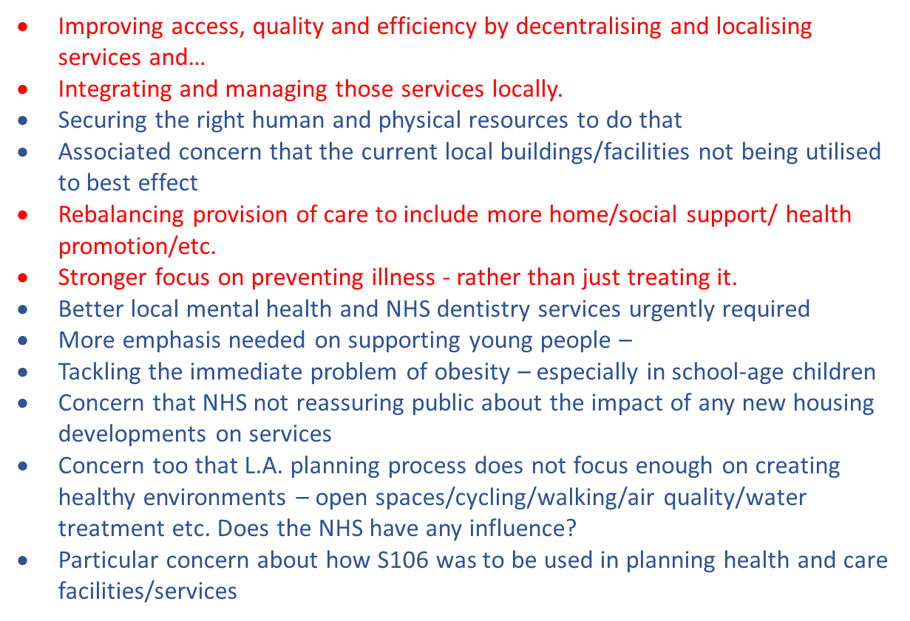

What we produced is a very good fit with the 10 Year Plan!
Including the urgent need for the health and care system to make three ‘shifts’:
from hospitals to neighbourhoods
from treatment to prevention
from old to new technology
The Plan also recognises that it is only by aligning the provision of care at local or neighbourhood level that efficient, high quality and accessible services will be delivered.

Slide 9
Faversham and the NHS 10 Year Plan – The Emerging Questions
What services currently provided in acute hospitals can be ‘localised’? When will this happen?
How quickly will the quality and accessibility of home, primary and community services improve? What about social care?
Will there be a single organisation with management responsibility for service planning and delivery in Faversham? How will local people and the voluntary sector be involved in in planning? How will local citizens hold the system to account?
How does the local authority and its services fit into all this?
What physical facilities will we need to deliver the new ‘devolved’ service pattern? Is there a plan for how the buildings funded by the NHS will be used?
How will the anticipated new ‘joined-up’ IT technology to support all this?
What moves will there be in terms of wider health promotion and disease prevention?

Slide 10
The Discussion

Slide 11
The ‘Big Live Talk’ Event
Faversham and the NHS 10 Year Plan – What Should We Expect?
Topic Area
…………………………………………………………………………………………….
…………………………………………………………………………………………….
…………………………………………………………………………………………….
…………………………………………………………………………………………….
…………………………………………………………………………………………….
…………………………………………………………………………………………….
…………………………………………………………………………………………….
…………………………………………………………………………………………….
…………………………………………………………………………………………….
…………………………………………………………………………………………….
…………………………………………………………………………………………….
…………………………………………………………………………………………….
…………………………………………………………………………………………….
…………………………………………………………………………………………….
…………………………………………………………………………………………….
…………………………………………………………………………………………….
…………………………………………………………………………………………….
…………………………………………………………………………………………….
………………………………………………………………………………..…….…….
………………………………………………………………………………..…….…….
……………………………………………………………………………………..….….
……………………………………………………………………………………...…….
……………………………………………………………………………………………..
…………………………………………………………………………..………………...
……………………………………………………………………………………………..
for
Other Issues
…………………………………………………………………………………………….
…………………………………………………………………………………………….
…………………………………………………………………………………………….
…………………………………………………………………………………………….
…………………………………………………………………………………………….
…………………………………………………………………………………………….
…………………………………………………………………………………………….
…………………………………………………………………………………………….
…………………………………………………………………………………………….
…………………………………………………………………………………………….
…………………………………………………………………………………………….
……………….…………………………………………………………………………….
…………………………………………………………………………………………….
…………………………………………………………………………………………….
…………………………………………………………………………………………….
…………………………………………………………………………………………….
…………………………………………………………………………………………….
…………………………………………………………………………………………….
…………………………………………………………………………………………….
…………………………………………………………………………………………….
…………………………………………………………………………………………….
…………………………………………………………………………………………….
…………………………………………………………………………………………….
……………………………………………………………………………………………..
……………………………………………………………………………………………..
Facilitator ……………………….
2nd October 2025

Slide 12
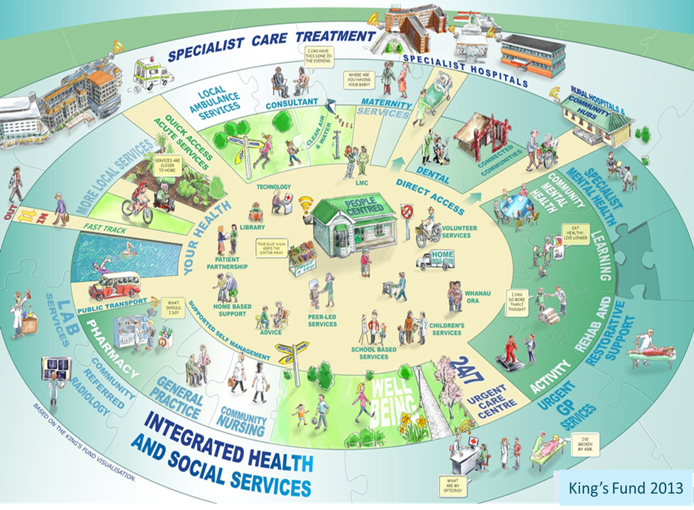
It might look like this…….
Notes:
This says it all . Localise decentralise integrated built around/with community etc etc. No need to go though it in any way – everybody has seen it before somewhere and will understand its significance. SO are you OK with it here?

Slide 13
The ‘Big Live Talk’ Health Event
Faversham and the NHS 10 Year Plan -
what should the neighbourhood expect?
Closing Remarks
Cedi Frederick,
Chair, Kent and Medway Integrated Care Board

Slide 14
CONTACT
https://favershamtowncouncil.gov.uk/directory/faversham-healthy-futures
Email: fhf@favershamtowncouncil.gov.uk

