Slide 1
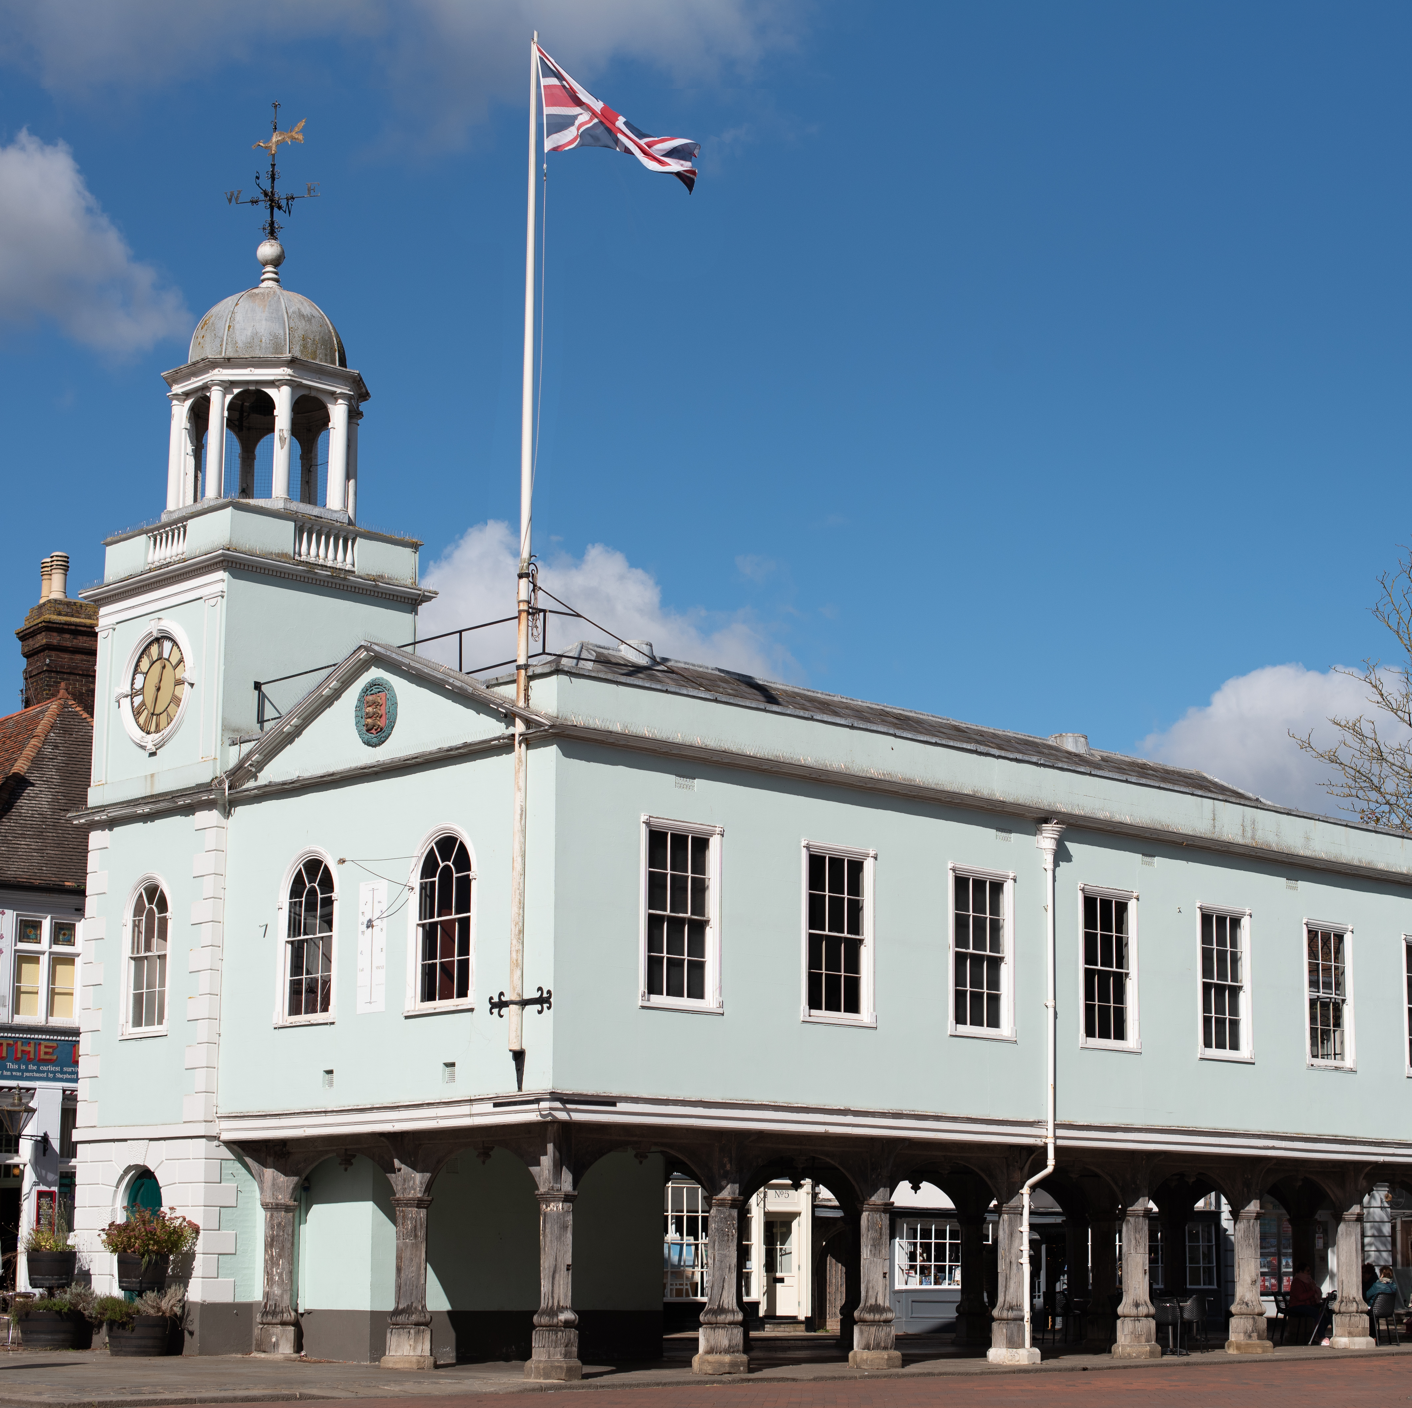
Annual Action Plan
2023-2024

Slide 2
Annual Action Plan 2023-2024
This document is an agreed summary of priority items for the current financial year and should be read alongside Faversham Town Council's Five Year Strategic Plan.
It is a ‘live’ document which the Town Council will update, enabling it to track and monitor its progress in delivering specific actions. The Plan and monitoring reports will be publicly available so residents will be able to judge the Council's progress.
Evaluating progress against the list of activities will be the responsibility of the Policy and Resources Committee. The Committee will ensure that each element of the Action Plan is considered and, where further work is needed, or there are any blockages to progress, appropriate action is taken.
The Strategic Plan will be reviewed each September, prior to budget setting, to keep the document relevant and up-to-date.
The Mayor of Faversham, Cllr Trevor Martin September 2023

Slide 3
Committees
Active Travel
Community
Environment
Policy and Resources

Slide 4
Working Groups
Heritage
Youth
Neighbourhood Plan
Faversham Creek
Equality, Diversity & Inclusion

Slide 5
Strategic Documents
Where the Annual Action Plan sits within our strategic documents
Strategic Plan
Medium Term Financial Plan
Community Engagement Plan
Annual Action Plan
Annual Budget
Standing Orders
Financial Regulations
Community Emergency Plan
Climate and Biodiversity Emergency Plan
Neighbourhood Plan
LCWIP

Slide 6
2023-2024 Timebound Actions
Successful Neigbhourhood Plan Referendum
Fighting the proposed closure of Faversham Household Waste Recycling Centre
Setting up Faversham & District Community Transport Scheme

Slide 7
1. Active Travel Actions
 | Project | Budget | Completion By
1.1 | LCWIP Revision and development of LCWIP (Consultant's fees) | £5,000 | March 2024
1.2 | LCWIP Outline drawings for further interventions (Designer's fees) | £7,500 | March 2024
2.3 | Active Travel Activities, events and publicity promoting active travel | £1,000 | March 2024
2.4 | Cross town walking route public engagement | £5,000 | March 2024
2.5 | Community Transport Scheme Develop the community bus scheme, working in partnership with others | £60,000 (grant) | December 2023 ongoing

Slide 8
2. Community Actions
 | Project | Budget | Completion By
2.1 | Community Engagement Develop a community engagement plan. | £500 | December 2023
2.2 | Events Organise national events at local level; ensure diversity of events and exhibitions held within council owned assets. | £0 | March 2024
2.3 | Physical and Mental Wellbeing community cohesion around poverty, social housing, GP and dental services | £0 | March 2024
2.4 | Crime/ASB Follow up crime research recommendations and work with other organisations in tackling anti-social behaviour | £10,000 | March 2024
2.5 | Youth Continue to provide funds for additional youth services, ensuring best value for money | £30,000 | March 2024

Slide 9
3. Environment Actions
 | Project | Budget | Completion By
3.1 | Best Practice Example Continue to work to be a best example in all matters climate and biodiversity | £0 | March 2024
3.2 | Pesticide Free Obtain Pesticide Free Town status | £1,000 | March 2024
3.3 | Climate Emergency Reaffirm the Town Council’s Climate and Biodiversity Action Plan | £0 | December 2023
3.4 | Partnerships Work with and support other organisations such as Faversham in Bloom | £0 | March 2024
3.5 | Faversham HWRC Campaign against the closure of Faversham’ tip | £4,500 | December 2023

Slide 10
4. Heritage Actions
 | Project | Budget | Completion By
4.1 | Maintenance of existing buildings in Town Council ownership | £10,000 | March 2024
4.2 | T S Hazard Facilitate the transfer of T S Hazard into Town Council ownership | £10,000 (grant) | March 2024
4.3 | Heritage Assets Better promotion of museums and heritage assets | £0 | March 2024
4.4 | Magna Carta Investigate the possibility of Magna Carta touring the US | £0 | March 2024
4.5 | Faversham Creek continue to campaign for an opening bridge | £1,000 | March 2024

Slide 11
5. Policy & Resources/Governance Actions
 | Project | Budget | Completion By
5.1 | Income Explore opportunities to increase income | £0 | January 2024
5.2 | Local Council Award Scheme Re-apply for Quality Gold Status | £500 | March 2024
5.3 | Neighbourhood Plan Successful at referendum | £10,000 | December 2023
5.4 | Allotments Complete the transfer of Perry Court allotments | £10,000 | December 2023
5.5 | Community Engagement Host events and workshops with the community to explain the tiers of local government and FTC budget proposals | £500 | January 2024

Slide 12
Version: 001-24.06.23

