Slide 1
Green Open Homes
Spring 2024: Project Proposal for Faversham
10 January 2024
Notes:
Having spoken with the Town Clerk, colleagues at Swale Borough Council and among Engagement and Behaviour Change and Energy teams at KCC, we would like to pilot this project in Faversham in Spring 2024. I am presenting this idea to you all today to get your support, and to make the most of our expertise and networks to help this succeed, and set an example for the rest of the county.

Slide 2
Why Green Open Homes?
Showcasing and incentivising Low Carbon Technology (LCT) installation
A focus on heat pumps is particularly beneficial
‘You can have a good look at the technology, ask the residents whether the installation was a hassle, and find out [how] much they’re really saving on their energy bills as a result.’ (Green Open Homes website)
Notes:
Energy efficiency retrofit can be a daunting space, for public sector colleagues and residents alike. People may find it difficult to trust salespeople due to vested interests, online databases are abundant, measures can be expensive and central government advice can be broad and/or misleading. A localised, community approach can help showcase and encourage LCT installation. Open Homes is not as novel as we think – let us not allow Kent to fall behind.

Slide 3
Why Faversham?
Faversham Neighbourhood Steering Group adopted the Net Zero Carbon Toolkit In October 2021.
There exists a sense of community and pride in the local area
~300 homes have heat pumps in Swale; around 100 of these are in Faversham
An opportunity to be an early mover in Kent
Notes:
Faversham is paving the way for sustainability. The Net Zero Toolkit outlines the need for energy eff retrofit, low carbon heat and renewables, using each where feasible and complementary to one another. Community groups lobby for causes related to planning and development, and groups such as Plastic Free Faversham and Friends of the Earth a great places to start with projects like Open Homes. The central Guildhall, for example, is used for many events and gatherings for charities and communities, and the multitude of annual festivals in Faversham illustrates the history, vibrance and capacity of this town to simultaneously celebrate its past and present while building future resilience.

Slide 4
Next steps
Delegate roles and arrange regular meetings to discuss
Decide upon event format and allocate stewards
Slot-booking for each home through Eventbrite
Promote the scheme to homeowners with LCT through networks and newsletters
Promote the scheme to all residents to attend events
Agree aims: monitor attendance, address and note popular queries and myths, ask if people are happy to be contacted by Councils in future (Eventbrite tick box)
Confirm dates: Sat. 6th April and Sat. 11th May 2024 avoid Bank Holidays and other local events

Slide 5
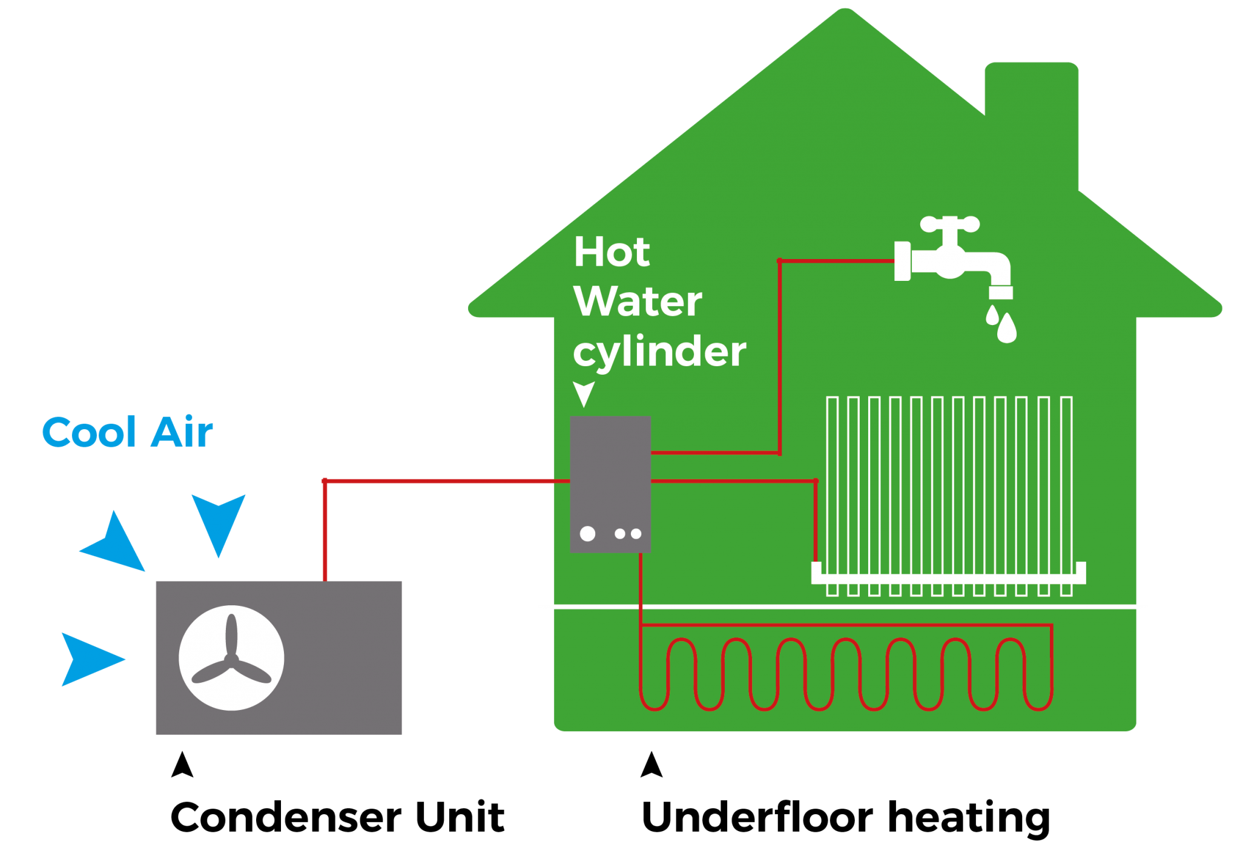
Thank you
Presented by: Victoria Frost, Community and Domestic Energy Support Officer, Kent County Council
Contact: Victoria.frost@kent.gov.uk

Slide 6
Sources
Faversham Town Council (FTC) (2021) https://favershamtowncouncil.gov.uk/wp-content/uploads/2021/11/netzero-carbon-toolkit_Faversham-.pdf
Green Open Homes (n.d) https://www.greenopenhomes.net/about [website] – includes useful guidance
Parity Pathways data (n.d.) https://parityprojects.com/services/local-authorities/ - using Public Sector information, OS and Royal Mail data
FTC Autumn Newsletter (2023) https://favershamtowncouncil.gov.uk/wp-content/uploads/2023/10/Autumn-Newsletter-2023-WEB.pdf
Explore Kent & Plastic Free Faversham (n.d.) https://explorekent.org/plastic-free-faversham/ [website]

